Slide 1
ICANN86
Production Planning Call No. 2
30 March @ 16:00 UTC

Slide 2
Agenda
Welcome & Introduction
Community Session Topic Vote Results
Discussion and finalization of Block Schedule
AOB

Slide 3
1. Welcome & Introduction

Slide 4
2. Community Session Topic Vote Results

Slide 5
Reminder Community Session Topic Timeline
Form circulated for Community Session topic submission: 2 March 2026
Submission deadline: 23 March 2026 at 23:59 UTC
ICANN86 Kick Off call & ICANN85 Debrief: 23 March 2026 15:00 UTC
Vote for Community Session topic: 24 – 27 March 2026
ICANN86 Production call #2, vote results & decision: 30 March 2026

Slide 6
GAC Community Topic Submission 1 of 2
Title: Cross-Community Dialogue on the Feasibility of a Platform for ASP-Supported New gTLDs
This plenary session would convene the community to assess the feasibility and implications of leveraging a platform through which new gTLDs supported by the Applicant Support Program (ASP) could transition toward operating their own back-end registry services. Building on GAC advice from ICAN79 and ICANN80 and subsequent exchanges with the ICANN Board, the session would provide a structured opportunity for cross-community dialogue involving the GAC, GNSO, ALAC, ICANN org, and other relevant stakeholders. The discussion would aim to clarify the scope and objectives of the proposed platform concept; examine operational, financial, and governance considerations; explore interactions with existing Registry Service Providers (RSPs) and the RSP framework; and consider ICANN’s potential role, consistent with its mission and remit. The session would be exploratory in nature, focused on developing a shared understanding of feasibility, policy implications, and potential next steps.
Description:
This plenary session would convene the community to assess the feasibility and implications of leveraging a platform through which new gTLDs supported by the Applicant Support Program (ASP) could transition toward operating their own back-end registry services. Building on GAC advice from ICANN79 and ICANN80 and subsequent exchanges with the ICANN Board, the session would provide a structured opportunity for cross-community dialogue involving the GAC, GNSO, ALAC, ICANN org, and other relevant stakeholders. The discussion would aim to clarify the scope and objectives of the proposed platform concept; examine operational, financial, and governance considerations; explore interactions with existing Registry Service Providers (RSPs) and the RSP framework; and consider ICANN’s potential role, consistent with its mission and remit. The session would be exploratory in nature, focused on developing a shared understanding of feasibility, policy implications, and potential next steps.

Slide 7
GAC Community Topic Submission 2 of 2
Potential speakers;
GAC representative
GNSO Council representative
ALAC representative
Two ICANN org representatives (RSP framework & ASP implementation)
Neutral facilitator
Format:
Facilitated plenary dialogue with short framing interventions (5 – 7 mins each), followed by a moderated cross-community discussion and community engagement
Additional comments:
Advance circulation of concise background materials (relevant GAC advice, Board correspondence, and overview of the RSP framework and ASP scope) would support a focused discussion. Scheduling earlier in the meeting is recommended to allow follow-up discussions if needed.

Slide 8
BC/ SSAC Topic Submission 1/2
Title: The Current and Coming Impact of Artificial Intelligence on DNS Abuse
Description: This plenary is intended to educate the ICANN community on the rapidly emerging role of artificial intelligence (AI) in accelerating and transforming DNS abuse. While still in early stages, AI is poised to significantly increase the speed, scale, and sophistication of abuse campaigns, fundamentally changing the threat landscape facing the DNS ecosystem. AI is not only increasing the velocity and volume of attacks but also lowering the barrier to entry. AI-assisted tools now enable individuals with limited technical expertise to design and launch complex abuse campaigns that previously required specialized knowledge. As a result, the risk is no longer limited to well-resourced threat actors; smaller and less sophisticated actors can now generate highly effective phishing, domain generation, impersonation, and infrastructure abuse at scale. This shift represents a structural change in DNS abuse dynamics. AI is improving the quality and effectiveness of attacks, enabling rapid content generation, automated infrastructure creation, and adaptive targeting that can outpace traditional detection and mitigation approaches.

Slide 9
BC/ SSAC Topic Submission 2/2
Description continued: The plenary will bring together technical experts, security practitioners and policy stakeholders to examine:
How AI is currently being used in DNS abuse campaigns
How the threat is expected to evolve over the next 2 – 5 years
What this means for registries, registrars and the broader DNS ecosystem
Where ICANN can play a constructive role in coordination, awareness and mitigation
We will focus on three key areas: the democratization of attack tools, the move toward machine-speed abuse, and the potential for ICANN-led coordination in developing AI-resilient defenses. The session will be both informative as well as interactive, including audience participation and audience polling.
Potential Speakers:
John Crain, ICANN CTO
Peter Lowe, M3AAWG
Dr Neal Jeting, Interpol
Gabriel Andrews, FBI
Laurin Weissinger, Tufts University, SSAC Member
Others tbd

Slide 10
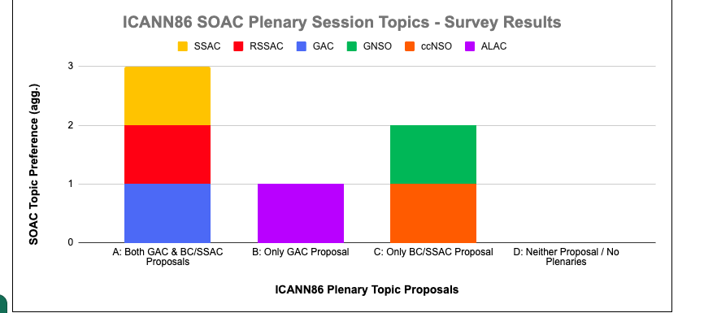
Survey Results

Slide 11
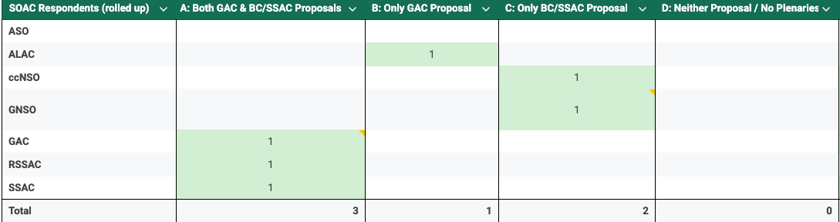
Summary of results

Slide 12
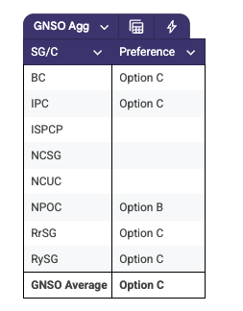
GNSO results aggregated
4 GNSO votes submitted for Option C (BC, RySG, RrSG, & IPC) and 1 vote for Option B (NPOC)

Slide 13
Additional comments received
SSAC: Suggest the BC/SSAC be scheduled on Monday. The GAC topic is relevant and will be informed by the discussions during the week and therefore may be best scheduled on Thursday.
BC: Prefer that the plenary take place early in the week. Thank you.
ccNSO: We suggest assigning ""Review of Reviews"" to Monday per the CCG’s request, and ""Impact of AI in DNS Abuse"" to Thursday to avoid overlapping with Tech Day on Monday. Tech Day previously discussed this topic in Dublin (https://icann84.sched.com/event/29QJy/ccnso-joint-tech-day-and-dns-abuse-session), so scheduling the session on Thursday allows Tech Day attendees to bring their insights and experiences, enriching the discussion. We believe this approach ensures both sessions to engage their audiences fully.
RySG: As this is the Policy Forum meeting and a Community Session, we would like to reiterate the importance of making this an interactive community session as opposed to the usual plenary format.
GAC: No strong preference on scheduling order, but emphasis on ensuring a regionally and gender-balanced lineup of speakers.
NPOC: We could support BC/SSAC proposal whether the panelists including females in the same number and relevance of participation.

Slide 14
3. Discussion and finalization Block Schedule

Slide 15
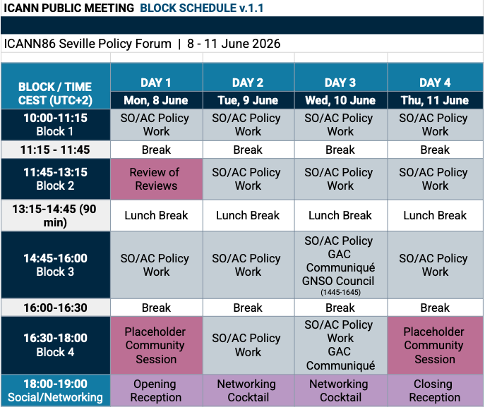
Draft Block Schedule ICANN86 v.1.1

Slide 16
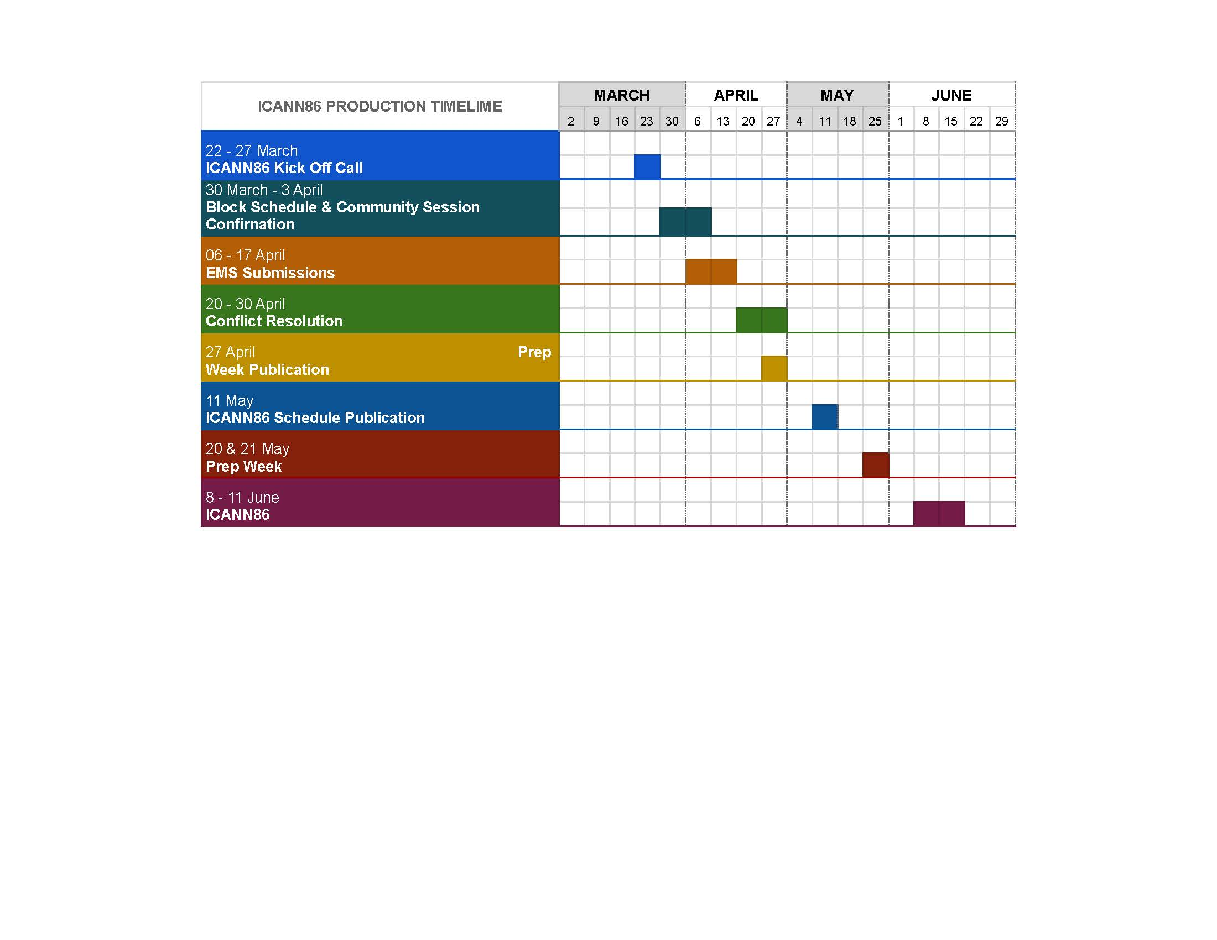
ICANN86 Production Timeline

Slide 17
4. AOB

Slide 18






Engage with ICANN
Thank You and Questions
Visit us at icann.org
Email: email@icann.org
@icann
facebook.com/icannorg
youtube.com/icannnews
flickr.com/icann
linkedin/company/icann
slideshare/icannpresentations
soundcloud/icann

