Slide 1
ICANN85
Production Planning Call No. 2
ICANN85 Planning
25 November @ 16:00 UTC

Slide 2
Agenda
Welcome & Introduction
Reminder of questions for Community Input
Community Input received to date
Draft ICANN85 Block Schedule incorporating changes
5. AOB Closing

Slide 3
1. Welcome & Introduction

Slide 4
2. Reminder of questions for Community Input

Slide 5
Outstanding questions for input from KickOff meeting
Community Sessions 1 & 2:
  Do you support scheduling a session on the Review of Reviews for Community Session 1?
  What other topics would you like to see discussion at the second Community Session, or would you rather see just the one Community Session on the schedule?
Geopolitical Forum:
  Do you support holding the Geopolitical Forum virtually as part of Prep Week for ICANN85?

Slide 6
3. Community Input received to date

Slide 7
Community Feedback to date
Feedback received from ALAC, ccNSO, EURALO, ISPCP, NCSG, RySG
Full support for one Community Session on the Review of Reviews
Other topics suggested for a possible second session: DNS Abuse (NCSG), WSIS +20 (ccNSO), How to Shorten the Time to Produce Effective Policies (EURALO), NXR Round update if warranted (RySG)
Broad support for the one Geopolitical Forum to be held during Prep Week, mild support for a second session to be held during ICANN86.

Slide 8
4. Draft ICANN85 Block Schedule incorporating changes

Slide 9
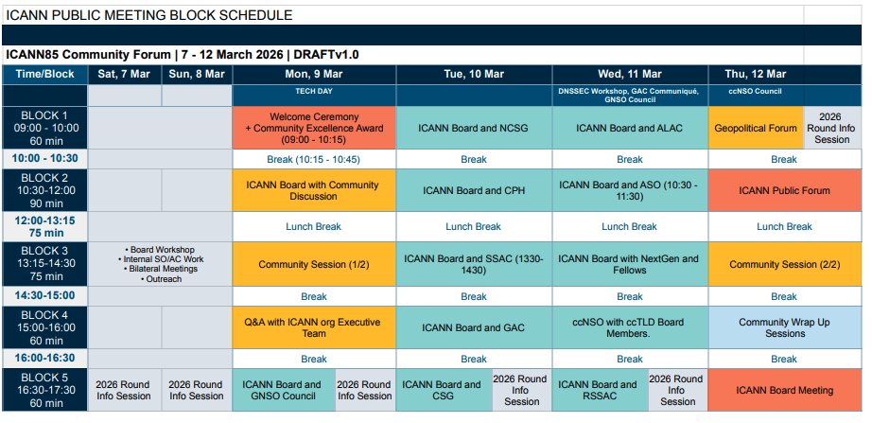
Draft Block Schedule ICANN85

Slide 10
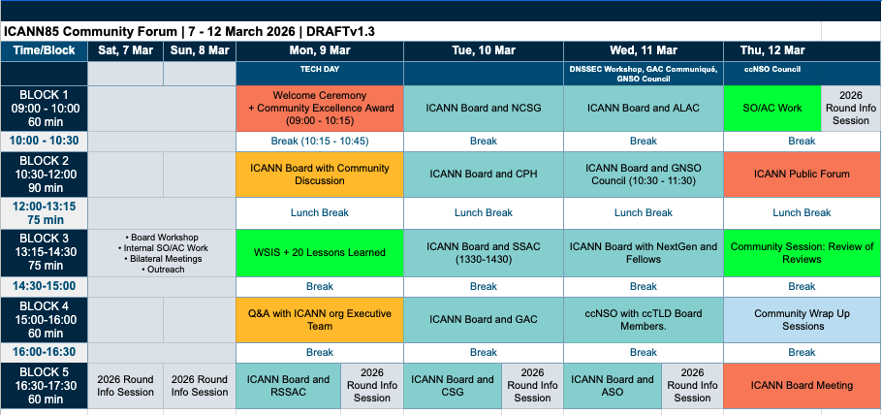
Suggested Block schedule with changes

Slide 11
5. AOB and Closing

Slide 12






Engage with ICANN
Thank You and Questions
Visit us at icann.org
Email: email@icann.org
@icann
facebook.com/icannorg
youtube.com/icannnews
flickr.com/icann
linkedin/company/icann
slideshare/icannpresentations
soundcloud/icann

