Slide 1
GNSO Noncommercial Stakeholder Group (NCSG)
The voice of Civil Society in GNSO and ICANN

Slide 2
NCSG
Direct members (individuals and organisations)
Constituencies:
  Non-Commercial Users Constituency
  Not-for-Profit Organizations Constituency

Slide 3
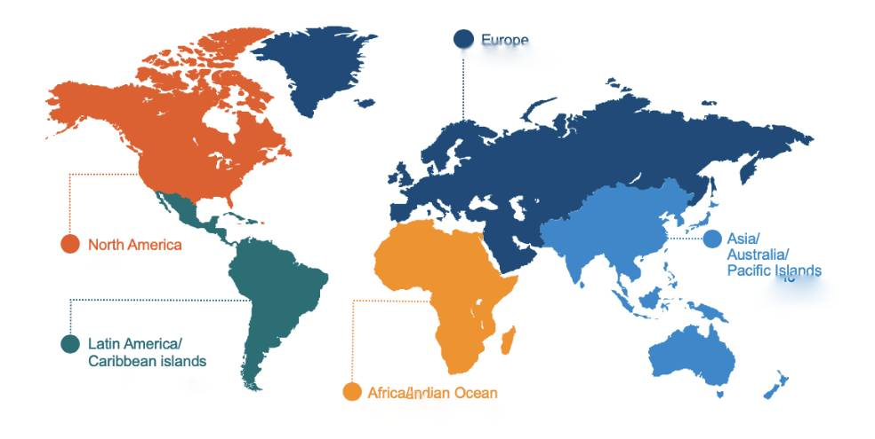
Diverse membership
NGOs, Academics, technical community

Slide 4
NCSG
6 Council representatives on GNSO Council
Executive Committee (EC)
  2 + 2 members + Chair
Policy Committee (PC)
  2 + 2 representatives + Council members + Chair + NCSG Chair (ex-officio)

Slide 5
  Non-Commercial Users Constituency (NCUC)
  Civil Society, individuals and organisations
  N active members
  https://www.ncuc.org

Slide 6
NCUC topics of interest
RDRS
New gTLDs Subpro
DNS Abuse
Statements of Interest (SOI)
Privacy and WHOIS
Geopolitical and regulatory issues affecting ICANN

Slide 7
  Not-for-Profit Organisations Constituency (NPOC)
  Non-profit organisations as domain users
  Provides voice for Not-for-Profit organisations and NGOs
  N active members
  Focus on engagement bringing in underrepresented geographies
  https://NPOC.org

Slide 8
Public mailing lists
https://listserv.syr.edu/scripts/wa.exe?A0=NCSG-DISCUSS
https://lists.ncsg.is/pipermail/ncsg-pc/
https://lists.ncsg.is/pipermail/ncsg-ec/
https://lists.ncuc.org/cgi-bin/mailman/listinfo/ncuc-discuss
https://mm.icann.org/mailman/listinfo/npoc-discuss

