Slide 1
ICANN87
Production Planning Call No. 2
16 July@ 17:00 UTC

Slide 2
Agenda
Welcome & Introduction
Community Session Topic Vote Results
Discussion and finalization of Block Schedule
AOB

Slide 3
1. Welcome & Introduction

Slide 4
2. Community Session Topic Vote Results

Slide 5
GAC Community Topic Submission 1 of 2
Title: Building a Secure, Inclusive, and Multilingual Internet for the Next Decade
As ICANN advances major initiatives across the DNS ecosystem, the community faces a common challenge: translating policy outcomes into meaningful implementation that benefits Internet users worldwide. This includes ongoing work on the next round of new gTLDs, Registration Data, DNS Abuse mitigation, Universal Acceptance (UA), and Internationalized Domain Names (IDNs).
This session would bring together stakeholders from across the ICANN community to explore how these efforts collectively contribute to a secure, stable, interoperable, and inclusive Internet. Particular attention would be given to the role of Universal Acceptance and multilingual Internet identifiers in enabling meaningful participation for underserved communities, supporting local languages and scripts, and ensuring that the benefits of digital transformation reach all users.
The discussion would focus on implementation challenges, opportunities for collaboration across the community, and practical steps needed to strengthen trust, security, accessibility, and inclusiveness in the DNS ecosystem over the coming decade.
Description:
This plenary session would convene the community to assess the feasibility and implications of leveraging a platform through which new gTLDs supported by the Applicant Support Program (ASP) could transition toward operating their own back-end registry services. Building on GAC advice from ICANN79 and ICANN80 and subsequent exchanges with the ICANN Board, the session would provide a structured opportunity for cross-community dialogue involving the GAC, GNSO, ALAC, ICANN org, and other relevant stakeholders. The discussion would aim to clarify the scope and objectives of the proposed platform concept; examine operational, financial, and governance considerations; explore interactions with existing Registry Service Providers (RSPs) and the RSP framework; and consider ICANN’s potential role, consistent with its mission and remit. The session would be exploratory in nature, focused on developing a shared understanding of feasibility, policy implications, and potential next steps.

Slide 6
GAC Community Topic Submission 2 of 2
This topic is relevant across the ICANN community, bringing together perspectives from the GAC, ALAC, GNSO, ccNSO, SSAC, RSSAC, the Board, and other stakeholders. It focuses on how ICANN can translate policy outcomes into effective implementation while advancing a secure, stable, inclusive, and multilingual Internet. The session would connect key ICANN priorities, including DNS Abuse, Registration Data, Universal Acceptance (UA), Internationalized Domain Names (IDNs), and the next round of new gTLDs, while identifying opportunities for collaboration and addressing implementation challenges. The discussion is particularly timely in light of the evolving digital governance landscape following the WSIS+20 review and implementation of the Global Digital Compact, highlighting ICANN's role in supporting an interoperable and inclusive Internet for all.
POTENTIAL SPEAKERS:
Representatives from GAC, ALAC, GNSO, ccNSO, SSAC, and UAWG and a moderator from ICANN org
FORMAT (e.g. panel discussion, open Q&A, etc.) :
Interactive and Mix format: Starting the session with the Moderator by an intro then launch a poll asking attendees 1 question, then questions to speakers, followed by open Q& A
Any additional comments: any polling platform with QR code for the poll

Slide 7
CPH/ NCSG Topic Submission 1/2
Title: The gap in registrant recourse - next steps.
Description: ICANN policies carry real consequences for domain name registrants. False positives in DNS Abuse Mitigation enforcement can lead to suspension or even deletion of domain names. The lack of a minimum standard recourse mechanism for registrants whose domains have been incorrectly suspended or hijacked are among the ways existing mechanisms fall short. Without clear and accessible recourse mechanisms, it can be nearly impossible for registrants to dispute or appeal any mitigation decision. The gaps in registrant recourse not only affect registrants' online presence, they can also disrupt end users' access to essential services, knowledge and information online.
Based on the work of the GNSO Small Team (https://gnso.icann.org/sites/default/files/policy/2025/draft/dns-abuse-small-team-report-04aug25-en.pdf [gnso.icann.org]) on DNS abuse, the Final Issue Report (https://gnso.icann.org/sites/default/files/policy/2025/draft/issue-report-dns-abuse-mitigation-04dec25-en.pdf [gnso.icann.org]) on a Policy Development Process on DNS Abuse Mitigation (published in December 2025) identified the Lack of Standard Dispute/Recourse Mechanisms for Registrants as a gap in ICANN's DNS abuse mitigation policy. The Transfer Review Policy Working Group similarly recognized one dimension of this problem and via Rec #33 recommended
(https://gnso.icann.org/sites/default/files/policy/2025/correspondence/tpr-team-to-gnso-council-04feb25-en.pdf [gnso.icann.org]) that the community develop a dispute resolution mechanism for hijacked domains, a recommendation that remains unaddressed.

Slide 8
CPH/ NCSG Topic Submission 2/2
Description continued: This session will examine the recourse mechanisms currently available to domain name registrants within the ICANN ecosystem, examine current practices utilised by registries and registrars, identify where the most significant gaps lie, and engage the community in a discussion about what concrete steps can be taken to strengthen and expand access to meaningful recourse for registrants
Potential Speakers:
Michaela Nakayama Shapiro (NCSG, ARTICLE 19) Bruce Tonkin (ccNSO, AuDA) RrSG (to be determined) Brian Cimbolic (RySG, PIR) Janos Drienyovski (GAC, European Commission)
Format:
Panel discussion with an open Q&A at the end.

Slide 9
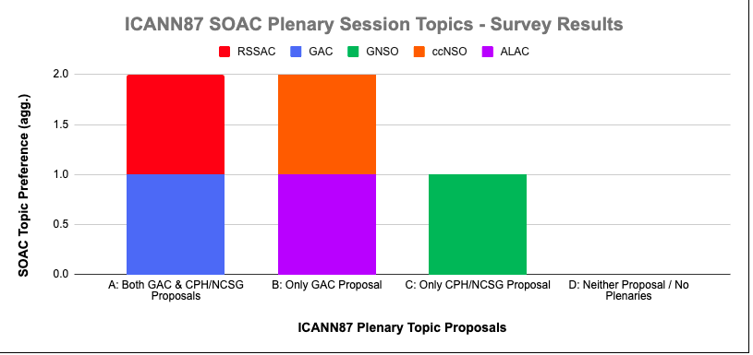
Survey Results

Slide 10
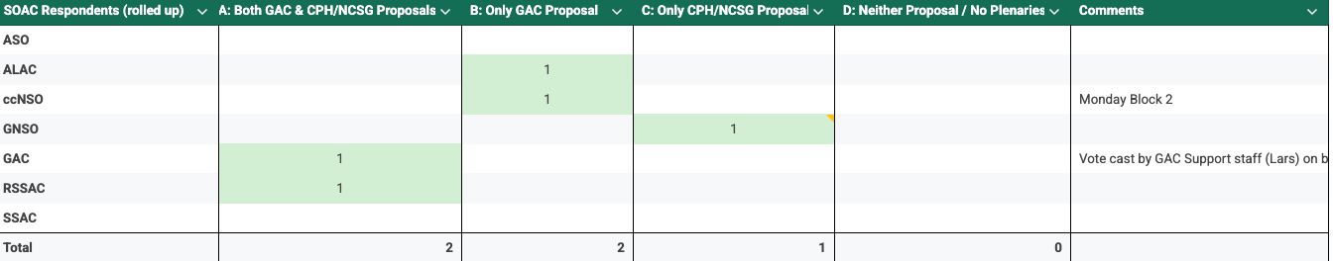
Summary of results

Slide 11
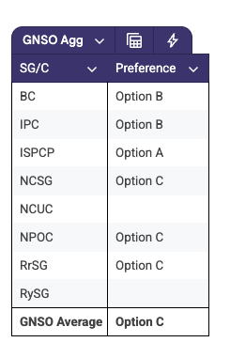
GNSO results aggregated
3 GNSO votes submitted for Option C (NCSG, NPOC, RrSG) 2 votes for Option A (BC and IPC), 1 vote for Option A (ISPCP)

Slide 12
Additional comments received
ccnso: GAC proposal community session to take place on Monday block 2

Slide 13
3. Discussion and finalization Block Schedule

Slide 14
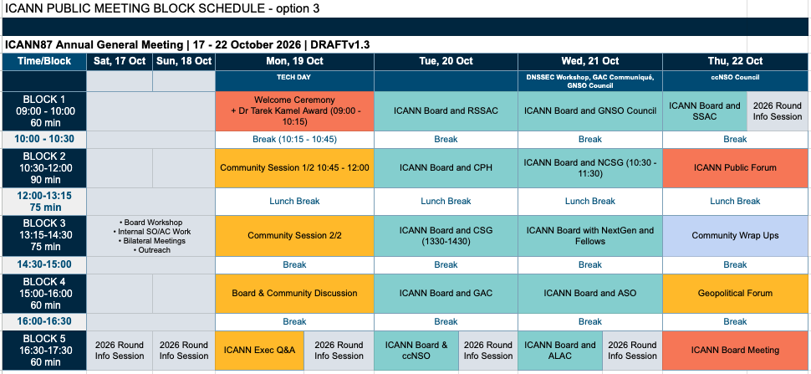
Draft Block Schedule ICANN87

Slide 15
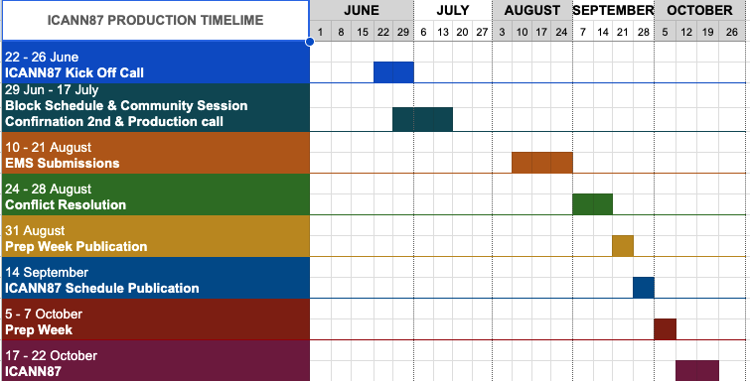
ICANN87 Production Timeline

Slide 16
4. AOB

Slide 17






Engage with ICANN
Thank You and Questions
Visit us at icann.org
Email: email@icann.org
@icann
facebook.com/icannorg
youtube.com/icannnews
flickr.com/icann
linkedin/company/icann
slideshare/icannpresentations
soundcloud/icann

