Slide 1
ICANN87 Kickoff
Production Planning Call No. 1
Feedback on ICANN86 and ICANN87 Planning Kickoff
24 June 2026 at 17:00 UTC

Slide 2
Agenda
Welcome & Introduction
Community Feedback on ICANN86
NEW Information on ICANN87: Venue & Logistics
Draft ICANN87 Block Schedule & Production timeline
Discussion: Community Priorities & Suggestions
6. AOB Closing

Slide 3
1. Welcome & Introduction

Slide 4
2. Community Feedback on ICANN86

Slide 5
3. NEW Information on ICANN87: Venue & Logistics

Slide 6
4. Draft ICANN87 Block Schedule & Production timeline

Slide 7
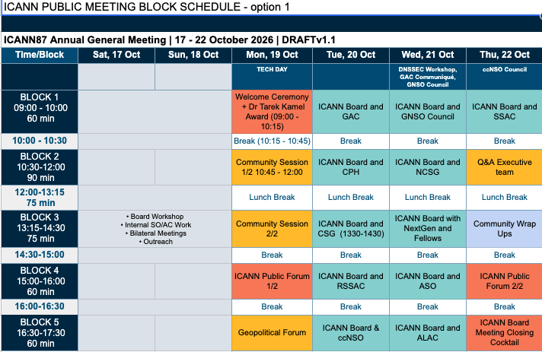
Draft Block Schedule ICANN87 Option 1.
2 Public Forums
2 Community sessions
(60 mins each)
1 Executive Q&A
1 Geo Forum

Slide 8
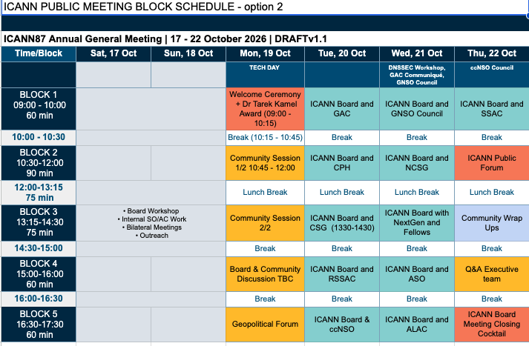
Draft Block Schedule ICANN87 Option 2.
1 Public Forum (90 mins)
2 Community Sessions
1 Exec Q&A
1 Geo Forum
1 Board & Community session

Slide 9
Pointers to keep in mind and questions for the group
Pointers:
The Q&A ICANN Org Executive Team is generally on Monday
The Next Round Team would like their sessions present on the Block Schedule as they did for ICANN85 (Mumbai) : end of day sessions with one or two plenary-type sessions.
Questions:
Is there a need to the Board & Community Engagement Discussion (How We Meet recommendations)
Would you like to see one or two Community Sessions?
Is the Geo Forum a session you still would like to attend in person or would you prefer it be held during Prep Week?

Slide 10
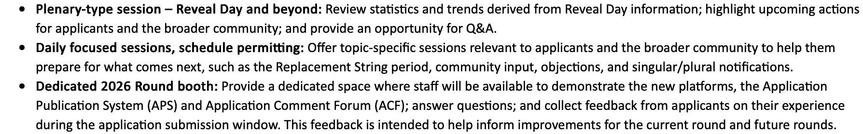
Next Round Request for ICANN87

Slide 11
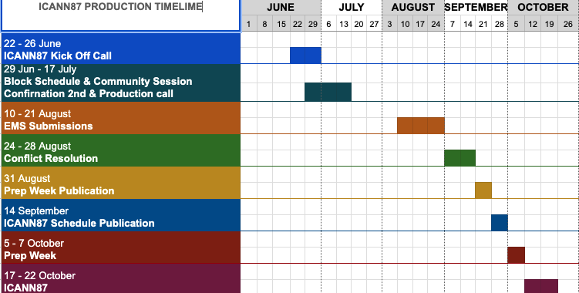
ICANN87 Production Timeline

Slide 12
5. Discussion: Community priorities & Suggestions

Slide 13






Engage with ICANN
Thank You and Questions
Visit us at icann.org
Email: email@icann.org
@icann
facebook.com/icannorg
youtube.com/icannnews
flickr.com/icann
linkedin/company/icann
slideshare/icannpresentations
soundcloud/icann

