Slide 1


Joint Session
SSAC and NCSG

Slide 2
Agenda
NCSG Topics
SSAC Topic
  Update on SSAC open meetings
  New Member Outreach

Slide 3

The majority of our work sessions are now OPEN to observers
We also offer additional engagement opportunities!
Public Information Session:
Get updates on hot topics the SSAC is examining
Engage in Q&A with SSAC members.
Learn more about the SSAC's work and its impact on the global internet community.
Wednesday, Block 2, Room 208 BC
Open Forum:
An informal drop-in session to connect directly with SSAC members.
Ask questions about becoming a member and contributing to the SSAC's mission.
Get answers to any questions you may have about other SSAC sessions throughout the week.
Thursday, Block 1, Room 103 B

Slide 4
New Member Outreach
Tara Whalen

Slide 5
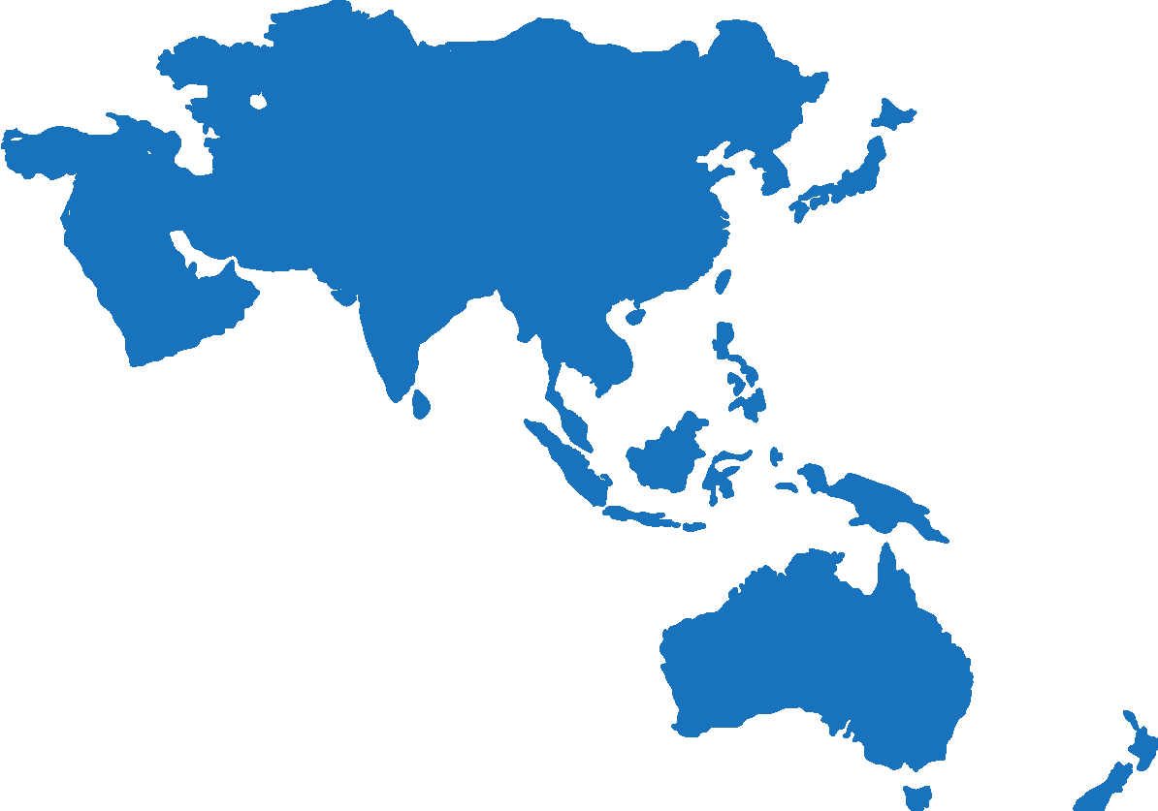









You can strengthen the SSAC with your unique perspective
SSAC tackles crucial cybersecurity challenges for the global Internet
We are currently short of qualified members in:
  Africa, Latin America, and Asia-Pacific
  Academic and research backgrounds
We are (many) more men than women
We currently have no members in Latin America/Caribbean Islands or in Africa. We have very few members in Asia/Pacific.

Slide 6
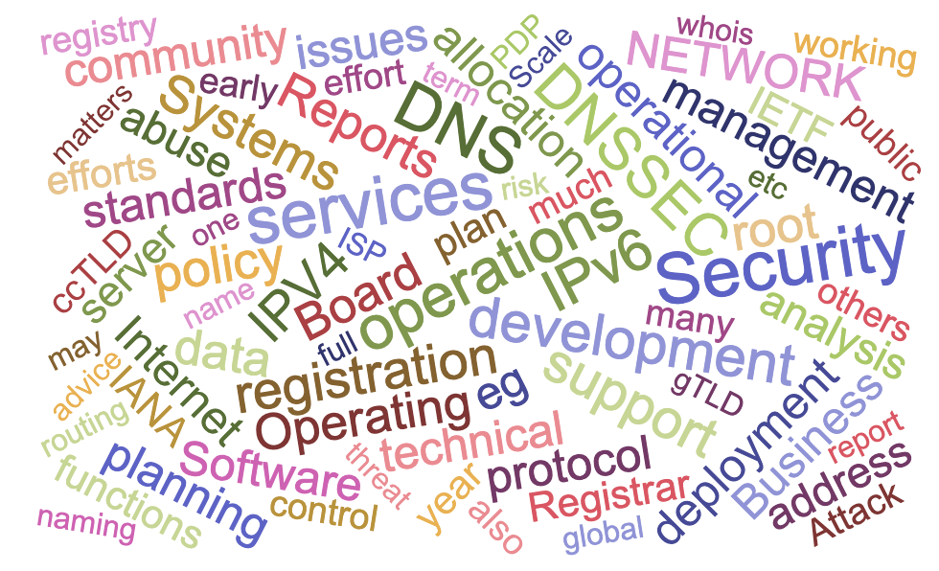
What We Look for in New Members…

Slide 7


Join us and help shape the future of a secure Internet
Deep engagement on crucial security matters
Exposure to global security and stability topics
Interaction with renowned security experts
Career-enhancing research and roles
International visibility at top security forums around the world
Advise the ICANN Board and global DNS community
Contribute directly to ICANN's mission
Build a safer, open internet
Apply to be a member and join us in making a difference!
  Check out our application instructions on the SSAC website and apply here.

