Slide 1
Non-Commercial Stakeholders Group
An Introduction and Guide to ICANN 63
14 June 2018

Slide 2
The Non-Commercial Stakeholder(s) Group
Non-Commercial Stakeholder Group (NCSG)
The NCSG is the home in the Generic Names Supporting Organization (GNSO) for civil society organizations, non-profit organizations, public interest groups, and individuals who are primarily concerned with the non-commercial, public interest aspects of domain name policy.
NCSG also represents non-commercial interests in other ICANN processes, for example structural and organizational reviews, cross-community working groups (CCWG) (NCUC and NPOC as well as unaffiliated members may also often participate in these activities).

Slide 3
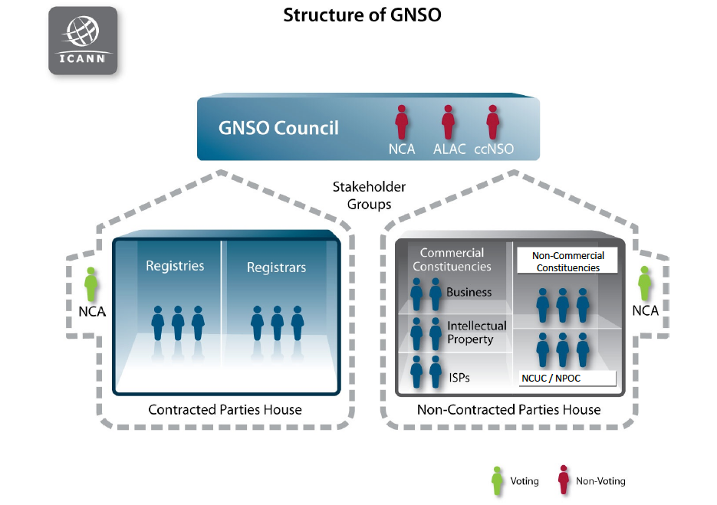

Slide 4
NCSG Constituencies
Noncommercial Users Constituency (NCUC)
The NCUC advocates positions on domain name-related policies that protect and support non-commercial communication and activity on the Internet.
Not-for-profit Operational Concerns Constituency (NPOC)
NPOC focuses on the impact of DNS policies on the operational readiness and implementation of non-commercial missions and objectives.

Slide 5
What do we do at NCSG? NCSG values?
We protect freedom of speech in domain name policy by:
- Preventing intellectual property interests and government interest overreach when it comes to generic domain names
- Preventing ICANN from becoming a content regulator (for example by requiring registries and registrars to take down content)
Keeping the definition of DNS abuse limited to a technical definition so ICANN does not become a content regulator (copyright lawyers argue copyright infringement is DNS abuse, which is false)
Privacy
- Bringing privacy to WHOIS (we are on the side of privacy protection not open WHOIS)
Global Access to Domain Names
Human Rights protections in general

Slide 6
What is outside NCSG's remit?
Internet access (as relates to physical infrastructure such as broadband)
Development issues that are not related to Domain Name Policy
Internet governance issues that do not directly relate to domain name policy

Slide 7
How we bring our values in ICANN policy processes?
Elected 6 members of the GNSO council
- Through the GNSO Non-Contracted Parties House (NCPH) elect 1 Director to the ICANN Board
NCUC/NPOC/NCSG members get involved in Policy Development Processes
Monitoring ICANN activities/statements
Writing public comments and statements
Informing people about our work, why they should join by organizing:
Outreach events during regular ICANN meetings
Outreach events at various Internet governance conferences

Slide 8
Policy and Other Groups, Key Words
ICANN meetings can be confusing so use these tips to find your way:
Look for GNSO Council meetings (we belong to GNSO, we can observe their work and discussions).
Look for the acronym “PDP” if you want to attend policy development sessions. PDPs are created by the GNSO, open to everyone but the final policy outcome will need to be voted on by GNSO council members.
Look for the acronym “CCWG” if you want to attend sessions that discuss issues that are not PDP issues but issues that all the groups at ICANN have chartered to work on, for example accountability of ICANN or ICANN in Internet Governance.
Cross Community session or “CC” are more of a debate and conversation sessions. Policy decisions will not be taken there. They are normally based on topics of CCWGs or PDPs.

Slide 9
What are we going to do at ICANN 63?
1. Advocate for strong data protection for domain name registrants in registration directory through :
Expedited Policy Development Process
Attending Cross Community session on GDPR
Discuss with the governments why privacy is important in WHOIS
2. Less politicization of the DNS/less trademark overreach
[Politicization of DNS happens when delegation of generic names in domain name space becomes a political matter]
Attend cross community and related PDP meetings related to New gTLDs sub pro. (the group that decides under what conditions the new generic names should be allocated, new generic names for example are .Papaya)
3. Prevent ICANN from becoming a content regulator
DNS abuse initiatives sometimes can lead to content regulation
Our goal is to keep the definition of DNS abuse technical
Follow the DNS abuse sessions during ICANN 63 and update NCSG

Slide 10
Relevant PDP meetings
PDP Working Group Meetings Temporary Specification for gTLD Registration Data
  Implications: privacy
New gTLD Subsequent Procedures
  Implications: Gov overreach/stringent criteria for applications
Review of All Rights Protection Mechanisms in All gTLD
  Implications: Trademark overreach

Slide 11
NCSG meeting with the Contracted Parties (registries/registrars)
Meetings with Contracted Party House (registries and registrars):
  We will meet with the Contracted Party House (the generic name registries and the registrars that register domain names)
    privacy of domain name registrants
    implementation of a new domain name data registry called RDAP

Slide 12
GAC and NCSG
Johan Julf Helsingius, the GNSO liaison to GAC and NCSG member will be there
We will discuss our perspective on Domain name registrants privacy, GDPR and what we want to achieve

Slide 13
NCSG meeting with Board
1. Does the Board keep track of finalized PDPs and public comments that it re-opens for the community? What is the Board approach in not overburdening the community with tasks that were finalized?
2. Does the Board believe that the whole community wants a unified access model to registrants personal information in WHOIS? What is the Board approach in gauging consensus in the community?
3. Regarding ICANN Org’s Human Rights Impact Assessment, will A) the specific assessment methodology and B) an unredacted version of Löning’s final report be made publicly available for community review?

Slide 14
GNSO: NCSG - Policy Committee at ICANN63
Discussions about GNSO Council meetings
Temporary specification : “This Temporary Specification for gTLD Registration Data (Temporary Specification) establishes temporary requirements to allow ICANN and gTLD registry operators and registrars to continue to comply with existing ICANN contractual requirements and community-developed policies in light of the GDPR.” This spec contractually obliges registries and registrars to take actions that directly affect the privacy of domain name registration (read about it here: https://www.icann.org/resources/pages/gtld-registration-data-specs-en)
Other PDPs progress
AOB

Slide 15
NCSG Open Session
NCSG Open Meeting
23 October; 15:15-18:30
15:15 - 15:20 | Welcome & Introductions
15:20 - 16:00 | NCSG goals and strategies
16.00 - 16:30 | Implementation/ achievements and way forward
16.30-16.45 | Brief reports about our meetings in the second half of NCSG Open session
16:30 - 17:00 | NomCom IPT leadership presentation (4:30 – 5:00) (During Coffee break)
17:00 - 17:30 | meeting with Budget team (TBD)
17:30 - 18:00 | SSR2
18:00 - 18:30 | ALAC

Slide 16
NCSG – CCWP on Human Rights
A working party on human rights which has members from across the community
Reach out to Collin Kurre for more information

Slide 17
NCSG/Perrin: Standardized Access
Half a day workshop on how standardized access to personal information of domain name registrants in registration directory is possible

Slide 18
NPOC and NCUC meetings
Both NPOC and NCUC will have constituency sessions which you can attend. Their agenda is on ICANN sched.
Joan (NPOC Chair)
Bruna (NCUC Chair)

Slide 19
Important Cross Community and High Interest Topic Sessions
Cross community sessions are not policy development (PDP) groups as such, but all the community groups (governments, end users, noncommercial stakeholders and others) will get together to discuss the important policy issues. HIT is mainly used by GNSO or other groups to provide updates on PDPs or one group’s activities
You can learn a lot by attending these meetings. Some of the most important ones are:
Cross Community session on GDPR
Hit session on EPDP

Slide 20
Read GNSO Policy Briefing Document
http://go.icann.org/gnsobriefing

