Slide 1
Non-Commercial Stakeholders Group
An Introduction
www.ncsg.is
14 June 2018

Slide 2
The Non-Commercial Stakeholder(s) Group
Non-Commercial Stakeholder Group (NCSG)
The NCSG is the home in the Generic Names Supporting Organization (GNSO) for civil society organizations, non-profit organizations, public interest groups, and individuals who are primarily concerned with the non-commercial, public interest aspects of domain name policy.
NCSG also represents non-commercial interests in other ICANN processes, for example structural and organizational reviews, cross-community working groups (CCWG) (NCUC and NPOC as well as unaffiliated members may also often participate in these activities).

Slide 3
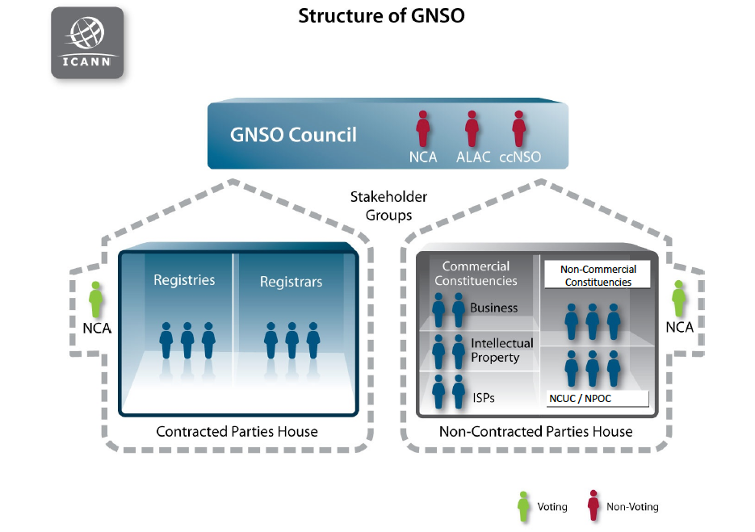

Slide 4
NCSG Constituencies
Noncommercial Users Constituency (NCUC)
The NCUC advocates positions on domain name-related policies that protect and support non-commercial communication and activity on the Internet.
Not-for-profit Operational Concerns Constituency (NPOC)
NPOC focuses on the impact of DNS policies on the operational readiness and implementation of non-commercial missions and objectives.

Slide 5
What do we do at NCSG? NCSG values?
We protect freedom of speech in domain name policy by:
- Preventing intellectual property interests and government overreach when it comes to generic domain names
- Preventing ICANN from becoming a content regulator (for example by requiring registries and registrars to take down content)
Keeping the definition of DNS abuse to a technical definition so ICANN does not become a content regulator (copyright lawyers argue copyright infringement is DNS abuse, which is false)
Privacy
- Bringing privacy to WHOIS (we are on the side of privacy protection not open WHOIS)
Global Access to Domain Names
Human Rights protections in general

Slide 6
What is outside NCSG's remit?
Internet access in terms of infrastructure for example broad band
Development issues that are not related to Domain Name Policy
Internet governance issues that do not directly relate to domain name policy

Slide 7
How we bring our values in ICANN policy processes?
Elected 6 members of the GNSO council
- Through the GNSO Non-Contracted Parties House (NCPH) elect 1 Director to the ICANN Board
NCUC/NPOC members get involved in Policy Development Processes
Monitoring ICANN activities/statements
Writing public comments and statements
Informing people about our work, why they should join by organizing:
Outreach events during regular ICANN meetings
Outreach events at various Internet governance conferences

Slide 8
NCSG Committees
1. Policy Committee: (consists of two appointed members of NPOC, two appointed members of NCUC, 6 NCSG elected councilors to GNSO Council). Responsibilities include issuing public comments on behalf of NCSG). The chair of NCSG PC is Rafik Dammak. https://lists.ncsg.is/mailman/listinfo/ncsg-pc
2. Executive Committee: consists of the Chair of NCSG (Farzaneh Badii), two appointed members of NPOC, two appointed members of NCUC. Responsibilities include membership approval and other administrative tasks as well as liaising with other ICANN groups and communities.
https://lists.ncsg.is/mailman/listinfo/ncsg-ec
3. Finance Committee: Consists of one NPOC appointee, one NCUC appointee and NCSG chair. The chair and treasurer of NCSG FC is Thato Mfikwe. Responsibilities include providing oversight for financial matters at NCSG
https://lists.ncsg.is/mailman/listinfo/ncsg-fc
Find the NCSG Committees members at this page: https://community.icann.org/display/gnsononcomstake/Committees-2018#Committees-912993224

