Slide 1

ALL THINGS WHOIS
Monday, 9 February 2015

Slide 2
Agenda
1
2
3
Exploring Identity Validation Checks
RAA WHOIS ACCURACY SPECIFICATION REVIEW
The WHOIS Roadmap
4
5
Next Steps for the EWG Report
Q&A
Notes:
This is a stylized agenda slide for your presentation.
To delete a box, if there are too many boxes, click the edge of the box, ensure the entire box is highlighted, then DELETE.
To update the numbers and text, click inside the circle for the numbers or in the box for the text, revise the text.

Slide 3
Panelists
James Bladel Chris Disspain Avri Doria
Godaddy ICANN Board NCSG
Susan Kawaguchi Brad Marden
Facebook Interpol

Slide 4
THE WHOIS ROADMAP
Jamie Hedlund

Slide 5
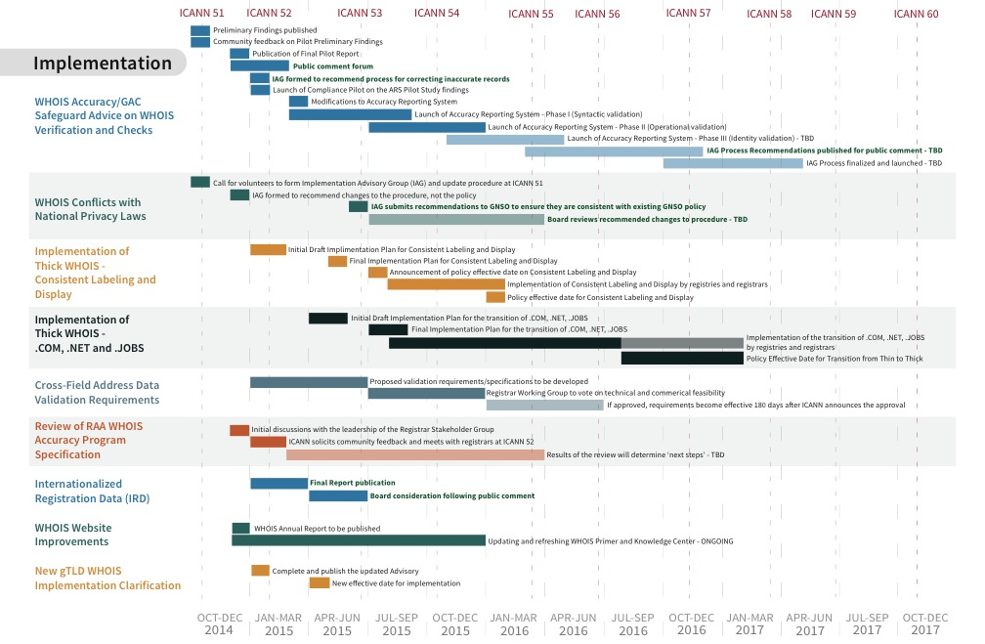
WHOIS Activities through 2017

Slide 6
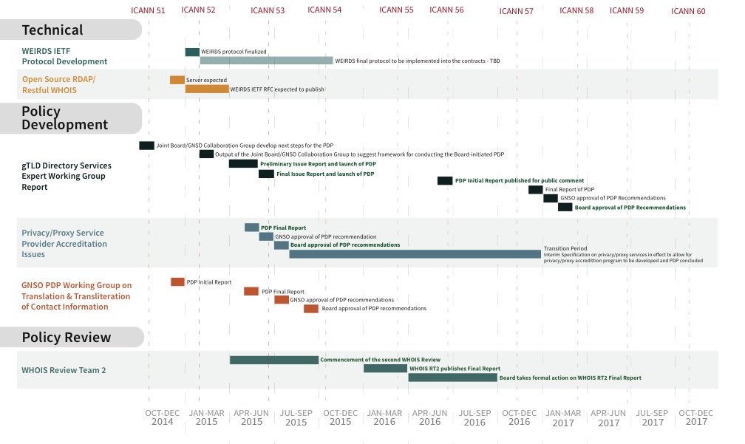
WHOIS Activities through 2017

Slide 7
WHOIS Accuracy Reporting System Design (ARS)
Exploring Identity Checks
Margie Milam

Slide 8

WHOIS Accuracy Reporting System
Part of 2012 ICANN Board directive to implement
WHOIS Review Team-recommended improvements
Approach
  Proactively identify inaccurate WHOIS records
  Explore using automated tools
  Forward potentially inaccurate records to registrars for action
  Publicly report on the resulting actions

Slide 9
WHOIS ARS Pilot Status & Next Steps
Pilot
Pilot Study completed by NORC tested Methodology using live data
Findings reflect 2013 RAA contributed to improved accuracy rates
Compliance Pilot underway to confirm findings & forward possible contractual related issues to registrars
Public Comment Open until Feb 28 2015
Feedback to Inform the final Design of the ARS
Question: Should ARS include identity validation checks?
Next Steps
Notes:
Summarize the three main points of your presentation here.

Slide 10
WHOIS ARS - Timeline
PILOT Launch
May 14
PILOT
Results
Oct. 14 - Feb 15
PHASE I
Mid 2015
PHASE II
Late 2015
PHASE III
TBD
Launch of RFP
Selection of vendors
Preliminary Findings
Public Comment on Pilot Report
Syntactical validation of:
Email
Telephone
Postal address
Operational validation of:
Email
Telephone
Postal address
Identity validation?
Integration of new systems
Notes:
To adjust the length and width of the arrow, click on the arrow, grab a corner, and lengthen or shorten, depending on your preference.
To add a bubble, click on the bubble, ensure it is fully highlighted, COPY and PASTE. Then drag the bubble to your preferred placement.
To delete a bubble, click on the bubble, ensuring it is highlighted and click DELETE. If you make a mistake, go to your top bar on PP and click EDIT, UNDO

Slide 11

Exploring Identity Validation
NORC Accuracy Pilot (2014)
  Syntactic and Operational Validation for sample of
  Registrant emails, postal addresses, & telephone numbers
Did not attempt Identity Validation due to
  Complexity and cost concerns
  What degree of validation is feasible/acceptable?
In this panel, we will further explore Identity Validation:
  Assessment that the data corresponds to the real world identity of the entity. It involves checking that a data item correctly represents the real world identity for the registrant. In general, identity validation checks are expected to require some manual intervention. – SAC058

Slide 12

WHOIS Identity Validation RFP Responses
WHOIS Online Accuracy Reporting System:
Request for Proposal issued in May 2014
Objective: Identify one or more vendors to provide services, software or data to support ICANN's development of the Accuracy Reporting System, including
  Verification and validation of WHOIS contact data, including postal address, email, telephone and registrant identity
Six (6) RFP respondents proposed Identity Validation services
  Research Organization
  Systems Integrator
  Credit Bureau
  Standards Body
  Industry-specific
  Verification Providers

Slide 13

Summary of Proposed Services
No standard, little consistency, but some patterns…
Common components
Most involve some degree of Syntactic and Operational validation,
in addition to identity validation and largely manual processes
Possible Approaches:
  Third Party Database checks vs. Interactive Registrant Validation
  Dependence on existing registration in external databases
  (e.g., corporate registration, photo ID, postal address)
  Database lookups
  Email validation
  Phone validation
  Postal validation

Slide 14

Discussion Questions for Panel
What is required to move beyond Syntactic and Operational Validation to Identity Validation?
Are third party database checks adequate?
  What makes a database reliable?
  How to address inconsistent quality of databases across regions?
Should registrants be contacted through the ARS to confirm their identity? How do we ensure they will respond?
Is interactive Identity Validation acceptable or reliable?
  Are there security concerns raised by reaching out to registrants?
Given the high costs, smaller sample sizes may be used. How do you ensure reliability?

Slide 15
Help Shape the Design of the ARS
Download Final Report:
http://whois.icann.org/sites/default/files/files/ars-pilot-23dec14-en.pdf
Comment Forum: Open Until 27 2015:
https://www.icann.org/public-comments/whois-ars-pilot-2014-12-23-en
Notes:
Further information available here – open the floor to Q&A

Slide 16
Questions on the ARS?
Notes:
Breakup your presentation, divide it into sections. This is especially useful if most of your presentation is text.

Slide 17
RAA Review of WHOIS Accuracy Obligations

Slide 18
WHOIS Accuracy Specification
2013 Registrar Accreditation Agreement (RAA) introduced new requirements:
Registrant & Account Holder “validation”:
  No empty, required fields
  Email addresses formed to spec (RFC 5322)
  Telephone numbers formed to spec (ITU-T E.164)
  Postal addresses formed to spec (UPU S42)
  Postal address fields jibe with each other (cross-field validation) –where technically and commercially feasible
Verification of either email or telephone number within 15 days
Deletion or suspension of registrations for willful inaccuracies or failure to respond
Section 6: Specification is be reviewed 1 year after the new RAA first executed

Slide 19
Discussion Questions for Panel
How have the newly implemented validation/verification requirements impacted various stakeholders:
  Registrars
  Intellectual Property Practicioners
  Businesses
  Registrants
  Law Enforcement Agents
  Others?
Should the requirements be updated or refined?
  Why?
  How?
  When?

Slide 20
Questions on the RAA Review?
Notes:
Breakup your presentation, divide it into sections. This is especially useful if most of your presentation is text.

Slide 21
The Future of Whois: Next Generation RDS
EP-WG | ICANN-52 | 9 February 2015

Slide 22

About the EWG Process WG (EP-WG)
ICANN Board is considering how to use the Expert Working Group (EWG) Final Report on Registration Directory Services (RDS) as input to a GNSO Policy Development Process (PDP) WG
The EP-WG is a collaboration between the GNSO and the Board, formed to recommend how to best structure PDP(s) for success
Board Members
Cherine Chalaby
Steve Crocker
Chris Disspain
Ram Mohan
Ray Plzak
Bruce Tonkin
GNSO Members
James Bladel, RrSG
Don Blumenthal, RySG
Ching Chiao, RySG
Avri Doria, NCSG
Susan Kawaguchi, BC
Dan Reed, Nom Com Appointee
Jonathan Robinson, GNSO Chair
Notes:
Formed at ICANN-51 to recommend a process for one or more PDP WGs to carry the ball forward on next-generation RDS.

Slide 23
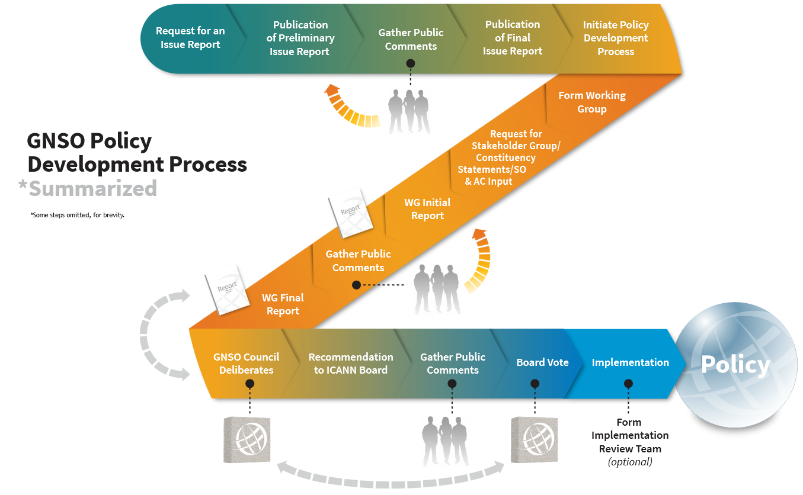
Where are we in the PDP process?
We are at this
stage of a
board-initiated PDP.
More specifically…
GNSO PDP Materials: http://gnso.icann.org/en/node/31379/
Notes:
Note that we are here in the current board-initiated PDP; however, the board may yet reframe their request before a new Preliminary Issue Report is published for comment

Slide 24
Where are we in the PDP process?
Nov 2012 | Board | ☒ Direct preparation of a (PDP) Issue Report
Nov 2012 | Board | ☒ Launch the EWG
Mar 2013 | Staff | ☒ PDP - Preliminary Issue Report
Mar-Apr 2013 | Community | ☒ Public Comment Forum (on above)
Jun 2013 | EWG | ☒ EWG Initial Report
Jun-Aug 2013 | Community | ☒ Public Comment Forum, Consultations (on above)
Nov 2013 | EWG | ☒ EWG Update Report
Dec-Feb 2014 | Community | ☒ Public Comment Forum, Consultations (on above)
Jun 2014 | EWG | ☒ EWG Final Report
Oct 2014- Feb 2015 | EP-WG | ☒ Develop Recommendations on PDP WG Process and Charter Guidance
Mar 2015 | Staff | ☐ New Preliminary Issue Report reflecting EP-WG output
May-Jun 2015 | Community | ☐ Public Comment Period on New Issue Report
July 2015 | Staff | ☐ Final Issue Report reflecting Public Comments
Aug-Sep 2015 | GNSO Council | ☐ Refine Charter for PDP Working Group
 | GNSO Council | ☐ Adopt Charter (start of PDP WG process)
Notes:
We are in the blue box now – yellow box reflects next steps.

Slide 25
EP-WG recommendations for RDS PDP WG
The EP-WG recommends a 3-Phase PDP WG approach:
https://community.icann.org/download/attachments/49359624/
RDS-PDP-Process-v8.pdf
Groups and sequences principles in the EWG’s Final Report
  Phase 1: Policy Requirements Definition (WHY)
  Phase 2: Policy Functional Design (WHAT)
  Phase 3: Implementation Guidance (HOW)
Pre-WG Steps: New Issue Report (including needed inputs and draft PDP WG Charter); Public Comment; Final Issue Report; GNSO Council consideration; PDP WG formation.
Post-WG Steps: GNSO Council and Board Approval; IRT Formation; Implementation informed by PDP WG guidance
Flow Charts
Notes:
EP-WG members have been meeting via conference calls since ICANN-51 – all calls are recorded and transcribed, available at https://community.icann.org/pages/viewpage.action?pageId=49359624.
The group drafted a 3-phase approach for a single PDP WG to develop policy for a next generation RDS. The recommended process spans areas identified in the EWG’s final report, in a systematic manner that incorporates inputs, manages dependencies, and allows for carefully-coordinated parallel policy design by WG subteams.
These EP-WG recommendations, as well as the EWG’s recommendations, will be rolled into a new Issue Report, to be published, commented upon, finalized, and considered by the GNSO Council.
After the PDP WG publishes its final report, the PDP process would continue with GNSO Council and Board approval prior to implementation.

Slide 26

Recommended 3-phase process flow
Preliminary Steps:
Issue Report &
Input Development
Phase 1:
Policy -
Requirements
Phase 2:
Policy -
Functional Design
Phase 3:
Implementation
Guidance
Next Steps:
GNSO Council Approval
Board Approval
IRT Formation
Implementation
Users/Purposes
A
Users/Purposes Reqs
B
Users/Purposes Design
C
Users/Purposes Guidance
Gated Access
A
Gated Access Reqs
C
Gated Access Design
D
Gated Access Guidance
Data Accuracy
A
Data Accuracy Reqs
C
Data Accuracy Design
D
Data Accuracy Guidance
Data Elements
A
Data Element Reqs
C
Data Element Design
D
Data Element Guidance
Inputs and
Phases for
each row
further
described
on slides 12-13
Privacy
A
Privacy Reqs
D
Privacy Design
E
Privacy Guidance
Compliance
A
Compliance Reqs
E
Compliance Design
F
Compliance Guidance
System Model
A
System Model Reqs
F
System Model Design
G
System Model Guidance
Cost Model
A
Cost Model Reqs
F
Cost Model Design
G
Cost Model Guidance
Benefit Analysis
A
Benefit Analysis Reqs
G
Benefit Analysis Design
H
Benefit Analysis Guidance
Risk Assessment
A
Risk Assessment Reqs
G
Risk Assess Design
H
Risk Assess Guidance
Input to PDP WG
Policy Development Process (PDP) Working Group
Output of PDP WG
[ Initiation of PDP ]
Approval of PDP Charter
A
… indicates proposed order to reflect inter-dependencies
indicates GNSO Council approval
Z
Notes:
This phased approach starts with using inputs to establish foundational policy in all areas, producing requirements to be approved by the GNSO Council. Next, PDP WG subteams would flesh out policy design in each area, possibly in parallel where dependencies and resourcing allow. During the final phase, PDP WG subteams would examine how policies in each area might be implemented, evaluating their feasibility, tweaking policy design, and developing implementation guidance.

Slide 27

Recommended methodology and timeline
Oversight
  GNSO Council should approve Phase 1 outputs
  before the PDP WG proceeds to Phase 2
  To ensure alignment with Phase 1 requirements, oversight should be provided by GNSO PDP WG coordination team
Timeline
  To foster sustained progress and timely completion,
  the WG should work towards a defined timeline and targets
  Phases 2-3 contain opportunities for parallel progress,
  sequenced for inter-dependencies, subject to resourcing
Methodology
  In addition to regular calls, PDP WG may hold periodic face-to-face meetings, including subteam and plenary meetings
Notes:
The EP-WG recommends a GNSO PDP WG coordination team consisting of (for example) the PDP WG chair, subchairs for each PDP WG subteam, and one or more GNSO Council liaison(s)

Slide 28
Next Step: Issue Report, Handoff to GNSO
Informal community feedback on EP-WG’s process recommendations welcomed at ICANN-52 “All Things Whois”
At the ICANN Board’s request, Staff will use EP-WG’s output to draft a new Preliminary Issue Report in March 2015, including EP-WG’s recommended process and a draft charter that will factor in this recommended process
Formal community feedback invited on this new Preliminary Issue Report during public comment period (April-May 2015)
Final Issue Report reflecting comments expected in July
GNSO Council will consider Final Issue Report and proposed Charter for PDP WG, followed by formation of PDP WG
Notes:
The EP-WG will take community feedback into consideration when finalizing its recommendations for a PDP WG process, methodology, and inputs, along with any guidance on the PDP WG’s charter. This output will be input to a new Preliminary Issue Report…

Slide 29
To learn more about the EP-WG and RDS
Visit the EP-WG’s Public Wiki: https://community.icann.org/pages/
viewpage.action?pageId=49359349
Download EWG’s Final Report: https://community.icann.org/pages/
viewpage.action?pageId=48343061
Read EWG’s RDS FAQs:
https://community.icann.org/
display/WG/EWG+FAQs
Watch EWG’s RDS Video FAQs:
https://community.icann.org/display/WG/
EWG+Multimedia+Frequently+Asked+Questions
Notes:
Further information available here – open the floor to Q&A

Slide 30
Questions on the EWG Next Steps?
Notes:
Breakup your presentation, divide it into sections. This is especially useful if most of your presentation is text.

Slide 31
General Q&A

Slide 32
Annex: EP-WG Flow Charts
Available for download from
https://community.icann.org/download/attachments/49359624/
RDS-PDP-Process-v8.pdf

Slide 33
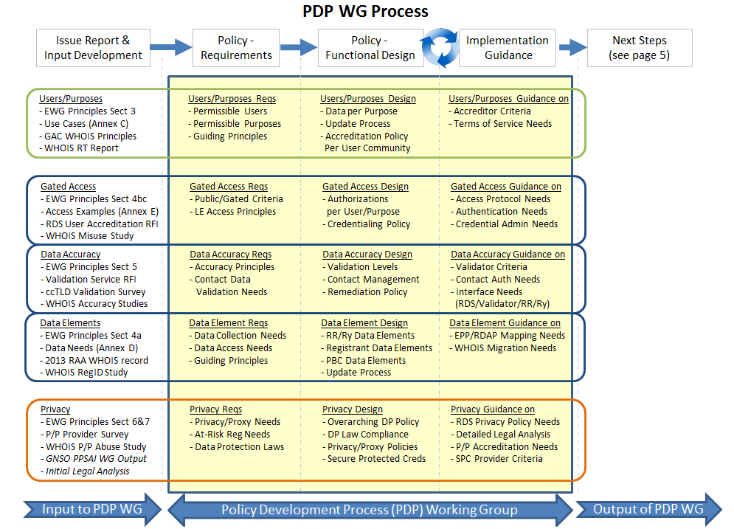
RDS PDP WG: Phased Flow Chart – Part 1 of 2
Available or To Be Developed
Notes:
On left, steps before the PDP WG starts include finalizing a new Issue Report and developing any inputs (shown here in italics) that are identified as required but not yet available.

Slide 34
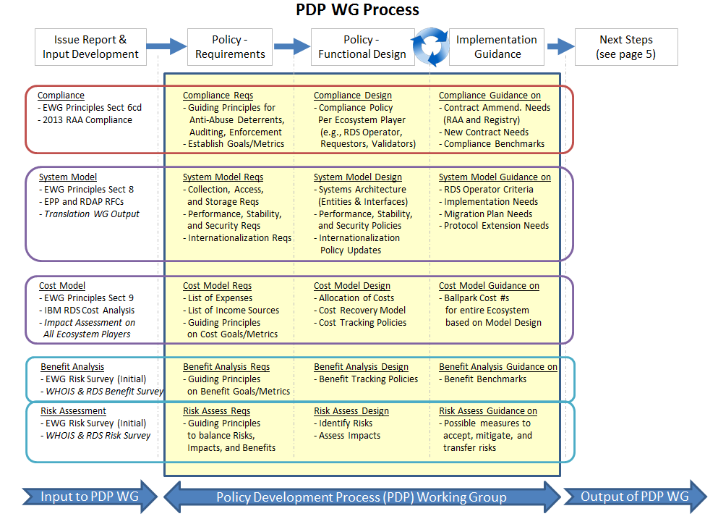
RDS PDP WG: Phased Flow Chart – Part 2 of 2
Available or To Be Developed

Slide 35
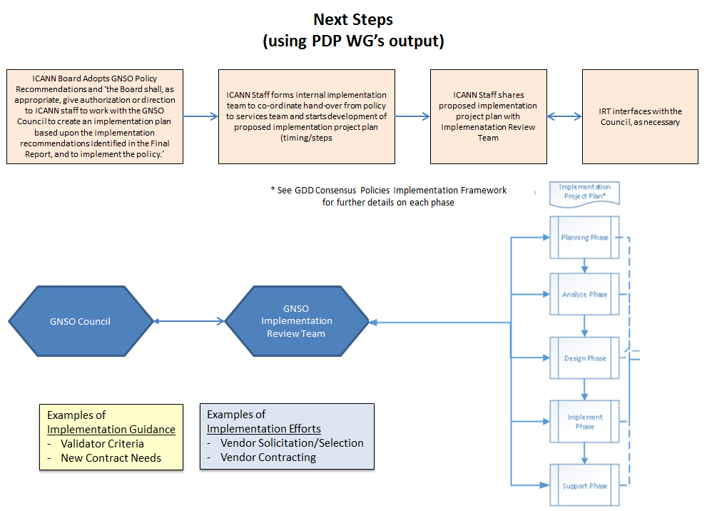
RDS PDP WG: Post-PDP WG Steps
Notes:
After the PDP WG completes its Final Report, the PDP process would continue through adoption before implementation, as shown here.

Slide 36
Annex: WHOIS Activity by Category

Slide 37
I. IMPLEMENTATION
WHOIS Activity | Description | Type of Activity | Timeline & Milestones | Related Activities
WHOIS Accuracy/GAC Safeguard Advice on WHOIS Verification and Checks | The new WHOIS Online Accuracy Reporting System is a key project linked to ICANN's strategic initiative to improve the overall effectiveness and accuracy of the WHOIS system. In response to the recommendations of the WHOIS Review Team, the system is designed to produce statistical reports on WHOIS accuracy rates. These reports will be made available on the WHOIS website on a periodic basis, providing visibility and transparency into whether accuracy levels are improving over time. ICANN will also rely on this system to comply with the GAC Beijing Advice regarding WHOIS verification and checks. | Contract implementation; WHOIS Review Team Recommendation implementation | Pilot Program RFP published, May 2014 Contracts executed, Aug. 2014 Preliminary Findings published, Oct. 2014 Community feedback on Pilot Preliminary Findings, Oct. 2014 Publication of Final Pilot Report, Dec. 2014 Public Comment Forum, Dec. 2014 – Feb. 2015 IAG to be formed to recommend process for the follow-up procedure, Jan. 2015 Launch of Compliance Pilot on the ARS Pilot Study findings, Jan. 2015 Initiate modifications to Accuracy Reporting System, Mar. 2015 Launch of Accuracy Reporting System – Phase I (Syntactic validation), mid 2015 Launch of Accuracy Reporting System – Phase II (Operational validation), late 2015 Launch of Accuracy Reporting System – Phase III (Identity validation), TBD IAG Process Recommendations published for public comment, TBD IAG Process finalized & launched, TBD

Slide 38
WHOIS Activity | Description | Type of Activity | Timeline & Milestones | Related Activities
WHOIS Conflicts with National Privacy Laws | Mandatory review of the effectiveness of the procedure under which registries and registrars may seek modification of their contractual WHOIS requirements in light of a conflict with national law. Currently, the process may only be invoked by the contracted party upon receiving notification of an investigation, litigation, regulatory proceeding or other government or civil action that might affect its compliance with the provisions of the RAA or other contractual agreement with ICANN dealing with the collection, display or distribution of personally identifiable data via WHOIS. | Contract implementation | Staff paper posted for public comment, May 2014 Comment period open, May –Aug. 2014 Analysis/proposed next steps provided to GNSO; call for volunteers to form Implementation Advisory Group (IAG) and update procedure, ICANN 51/LA, Oct. 2014 IAG formed to recommend changes to the procedure, not the policy, Dec. 2014 IAG submits recommendations to GNSO to ensure they are consistent with existing GNSO policy, June 2015 Board reviews recommended changes to procedure, TBD

Slide 39
WHOIS Activity | Description | Type of Activity | Timeline & Milestones | Related Activities
Implementation of Thick WHOIS – Consistent Labeling and Display of WHOIS across all current thick gTLDs | Implement recommendation #1 from the Final Report of the Thick WHOIS Policy Development Process for all current thick gTLDs | Policy implementation | Initial Draft Implementation Plan for Consistent Labeling and Display, Jan. –Feb. 2015 Final Implementation Plan for Consistent Labeling and Display, May 2015 Announcement of Policy Effective Date on Consistent Labeling and Display, July 2015 Implementation of Consistent Labeling and Display by Registries and Registrars, Aug. 2015 – Jan. 2016 Policy Effective Date for Consistent Labeling and Display, Jan. 2016
Implementation of Thick WHOIS – Transition form thin to thick WHOIS for .COM, .NET and .JOBS | Implement recommendation #1 and #3 from the Final Report of the Thick WHOIS Policy Development Process for the thin WHOIS gTLDS (.COM, .NET and .JOBS ) | Policy Implementation | Initial Draft Implementation Plan for transition of .COM, .NET, .JOBS, April – May 2015 Final Implementation Plan for the transition, July – Aug. 2015 Implementation of the transition of .COM, .NET, .JOBS by Registries and Registrars, Aug. 2015 – Aug. 2016/Jan. 2017 Policy Effective Date for Transition from Thin to Thick, Aug. 2016 – Jan. 2017

Slide 40
WHOIS Activity | Description | Type of Activity | Timeline & Milestones | Related Activities
Cross-Field Address Data Validation Requirements | The WHOIS Accuracy Program Specification of the 2013 RAA requires registrars to validate that all postal address fields are consistent across fields (for example: street exists in city, city exists in state/province, city matches postal code) where such information is technically and commercially feasible for the applicable country or territory. | Contract specification | Registrar working group was formed to ascertain the availability of technically and commercially feasible tools for cross-field validation. The group was dormant during the rollout of the 2013 RAA but is currently being reinitiated. Proposed validation requirements/ specifications to be developed by mid- 2015. Registrar Working Group to vote on technical and commercial feasibility in mid-to-late 2015. If approved, requirements become effective 180 days after ICANN announces the approval.
Review of RAA WHOIS Accuracy Program Specification | Terms and conditions of the WHOIS Accuracy Program Specification to be reviewed by ICANN in consultation with the Registrar Stakeholder Group on or about the first anniversary of the date that the RAA is first executed by a registrar. | Contract implementation | ICANN is planning the approach and proposed methodology for the review Initial discussions with the leadership of the Registrar Stakeholder Group began in December 2014 ICANN plans to solicit community feedback beginning in January 2015 and meet with registrars in Singapore in February 2015 Results of the review will determine ‘next steps’

Slide 41
WHOIS Activity | Description | Type of Activity | Timeline & Milestones |  | Related Activities
Internationalized Registration Data (IRD) | WHOIS RT made recommendations to charter a new IRD group to look at requirements holistically and to make recommendations in this area. | Recommenda-tions to form basis for further policy work and contract discussions; WHOIS Review Team Recom-mendation implementation. | Announcement for IRD Team, including call for applicants, July 2013 IRD Team selected, Sept. 2013 Preliminary Report published, June 2014 Interim Report from the Expert Working Group on Internationalized Registration Data published, April 2014 Interim Report posted for public comment, April – July 2014 Report of Public Comments on Interim Report published, 2 September 2014 Final Report publication, 1Q2015 Board consideration following public comment, 2Q2015 |  | GNSO PDP Working Group on Translation and Transliteration of Contact Information Expert Working Group on Next Generation gTLD Directory Services IETF WEIRDS work
WHOIS Activity | Description | Type of Activity |  | Timeline & Milestones | Related Activities
WHOIS Website Improvements | The WHOIS Website is to be refined & updated | Policy implementation |  | Online Search Tool enhancements WHOIS Annual Report to be published, Dec. 2014 Updating & Refreshing WHOIS Primer and the Knowledge Center, ongoing
New gTLD WHOIS Implementation Clarification | Advisory - Clarifications to New gTLD Registry Agree-ment, Spec. 4 and the 2013 RAA WHOIS Specification | Contract Implementation |  | Complete and publish the updated Advisory by Jan. 31 New effective date for implementation moved from mid-February to mid-April

Slide 42
II. TECHNICAL
WEIRDS IETF Protocol development | Development of new replacement of WHOIS protocol, RFC process underway in IETF | Technical | WEIRDS IETF Working Group formed, April 2012 WEIRDS protocol finalized, 1Q 2015 WEIRDS final protocol implemented into contracts, TBD | RDAP/Restful WHOIS
Open Source RDAP/Restful WHOIS | Develop a RESTful WHOIS open-source server for domain name registries that can be used by registries or registrars. The server will use the specifications developed in the IETF WEIRDS WG. | Technical | Server expected, Dec. 2014 WEIRDS IETF RFC expected to publish, 1Q 2015 | Dependent on development of WEIRDS protocol

Slide 43
III. POLICY
WHOIS Activity | Description | Type of Activity | Timeline & Milestones | Related Activities
gTLD Directory Services Expert Working Group Report | Final Report from the Expert Working Group on gTLD Directory Services (EWG) details recommendations for a next-generation Registration Directory Service (RDS) to replace the current WHOIS system. | Policy development; WHOIS Review Team Recommenda-tion implementation | EWG formed, Dec. 2012 Publication of Initial Report, Frequently Asked Questions, and online questionnaire, June 2013, kicking off an extensive consultation process within the ICANN community on the initial recommendations. Final Report published and delivered for consideration by the ICANN Board at ICANN50 in London, June 2014 Following discussions in London on the interplay between the EWG Final Report and the Board-initiated PDP requested by the Board in Nov. 2012 (which had been put on hold pending the EWG work), the Board and GNSO agreed to form a joint GNSO – Board collaboration group to develop next steps for the PDP, Oct. 2014 Output of the Joint Board/GNSO Collaboration Group to suggest framework for conducting the Board-initiated PDP, expected Feb. 2015 Preliminary Issue Report & Public Comment Forum, April-May 2015 Final Issue Report & Launch of PDP, June 2015 PDP Initial Report published for public comment, June 2016 Final Report of PDP, Dec. 2016 GNSO Approval of PDP Recommendations, Jan. 2017 Board Approval of PDP Recs 2/17 | Pending GNSO PDP

Slide 44
WHOIS Activity | Description | Type of Activity | Timeline & Milestones | Related Activities
Privacy/Proxy Service Provider Accreditation issues | Board-initiated GNSO PDP to develop policy recommendations to guide ICANN’s implementation of an accreditation program for privacy and proxy service providers. This topic was identified during the 2013 RAA negotiations and recommended for community policy development. | Policy development; WHOIS Review Team Recommendation implementation | GNSO launched PDP, Oct. 2013 WG charter adopted, Oct. 2013 PDP Final Report, estimated May 2015 GNSO approval of PDP recommendation, estimated June 2015 Board Approval of PDP recommendations, estimated July 2015 Transition Period – Interim Specification on privacy/proxy services in effect until 1/1/17 to allow for privacy/proxy accreditation program to be developed and PDP to be concluded. (See Specification on Privacy & Proxy Registrations in the 2013 RAA) Staff has begun pre-implementation preparations in consultation with the Working Group

Slide 45
WHOIS Activity | Description | Type of Activity | Timeline & Milestones | Related Activities
GNSO PDP Working Group on Translation and Transliteration of Contact Information | The PDP WG is tasked with developing a policy recommendation regarding the translation and transliteration of registration contact information. Among other things, the WG was to consider whether it is desirable to translate contact information to a single common language or transliterate contact information to a single common script. They were also expected to consider the question who should decide who should bear the burden of translating contact information to a single common language or transliterating contact information to a single common script. The PDP includes study on the commercial feasibility of translation and transliteration systems for internationalized contact data | Policy development | GNSO Council requested an Issue Report, Oct. 2012 GNSO initiates PDP, June 2013 PDP Initial Report submitted 15 Dec. 2014 PDP Final Report, estimated May 2015 GNSO approval of PDP recommendations, estimated July 2015 Board Approval of PDP recommendations, estimated Sept. 2015 | Expert Working Group on Internationalized Registration Data (IRD)

Slide 46
POLICY REVIEW
WHOIS Activity | Description | Type of Activity | Timeline & Milestones | Related Activities
WHOIS Review Team 2 | The Affirmation of Commitments requires a review of ICANN’s WHOIS policy and requirements every three years. | Policy review | Commencement of second WHOIS Review, mid-2015. WHOIS RT2 publishes final report, early 2016 Board takes formal action on WHOIS RT2 Final Report, mid-2016

